Slide 1
Assessing Importers’ Groupage in Sierra Leone
Wednesday 7th December 2022

Slide 2
Contents
Background
Motivation for the study
Objectives
Methodology
GST Structure
Key Findings
Recommendations

Slide 3
Introduction
This study was commissioned and funded by Invest Salone (ISL)
ISL is UK Foreign Commonwealth & Development Office (FCDO) funded program which aims to help Sierra Leone realise the benefit of international trade by facilitating domestic and foreign investment in tradable sectors through three high level workstreams: Investment climate reform, market development and Investment and Export promotion

Slide 4
Motivation of the Study
During a public-private dialogue (PPD) between NRA and Importers Association of Sierra Leone, the Association highlighted several import constraints among which was their claim of incorrect groupage GST calculations
They asserted that GST was calculated and paid for by the lead importer (whose name is on the bill of lading) on behalf of other members constituting the group.
Hence, some groupage importers who are mainly small and medium entrepreneurs are now being given electronic cash registers and must add GST when they trade their goods on a retail basis and then reconcile with NRA.

Slide 5
Objectives
Analysis of the process of groupage in Sierra Leone (Ports and Gbalamuya)
Use the analysis to further look at GST computation for groupage

Slide 6
Methodology
Research method
Qualitative method
Data collection method
Documentary review
Interviews with key stakeholders
Observation
Interviewees were sampled by purposive and snowballing sampling techniques

Slide 7
Groupage and Goods & Services Tax
Groupage (less than container load) occurs when several importers combine resources to bring in a consignment of goods but the paperwork attributes ownership to just one of the several taxpayers (consignees) involved.
GST is calculated and paid by the lead importer (whose name is on the import document) on behalf of other members of the groupage.
These members must add GST when they trade their goods on a retail basis and pass on the GST to NRA but are unable to off-set against GST paid on import because the Tax is not linked to their individual identification numbers

Slide 8
Groupage and Goods & Services Tax cont’d
According to section 15 (1) of the GST Act, 2009, a person is required to apply for GST registration if:
The person exceeded the registration threshold in the period of 12 months or lesser months ending on that day;
The person exceeded one-third of the registration threshold in the period of 4 months ending on that day; or
There are reasonable grounds to expect that the person will exceed the registration threshold in the twelve-month period commencing on the following day:
Registration threshold:
GST turnover of taxable supplies in any twelve month month period exceeding Le 200 million (US$ 50,000) and may be amended by statutory instruments
This threshold was revised upwards in 2015 to Le 350 million (US$ 70,000)
Finance Act 2022 revised the threshold downwards to Le 100 million (US$ 8,800)

Slide 9
GST Process of Groupage at the Port
Importers go through a clearing and forwarding agent/Individual agent to clear their goods
Formal Groupage Importers
Goods are cleared by CFA
Goods are classified as merchandise and assessed based on value in delivery order and charged import GST
Importers meeting the GST threshold and are registered can reconcile their import GST if goods are sold

Slide 10
GST Process of Groupage at the Port cont’d
Informal groupage importers
Only one Consignee acting on behalf of the groupage importers
Consignee's name is on the bill of lading
Goods are mostly classified as baggage and a flat rate is applied to a 20ft or 40 ft container (in some cases the rate is increased based on the value of the goods)

Slide 11
GST Process of Groupage at Gbalamuya
Import GST is applied to the value of goods
Assessment of goods in the haulage trucks is done through a simplified declaration form.
Formal/Informal groupage importers

Slide 12
Findings: Port
GST registration threshold is too low compared to other countries
Two categories of groupage importers
Formal and Informal groupage importers
The low threshold and depreciation of the NLe is bringing in small and medium enterprises into the threshold for registration
At 2010 dollar value (US$ 50,000), the GST registration threshold in 2022 will be NLe 920,000
At 2015 dollar value (US$ 70,000) the GST registration threshold in 2022 will be NLE 1.288,000
Informal system only allows for one Consignee and prevents importers from making claims on import GST
Importers regard the process of clearing as too cumbersome

Slide 13
Findings: Land Border
Groupage trade along the land border is predominantly done by small and medium scale traders from all parts of the country
Traders handover their goods to chartermen, who have hired truck from Conakry or Pamalap
The ‘chartermen’ act as Consignees and they are responsible for clearing the goods
Traders are comfortable in paying import GST

Slide 14
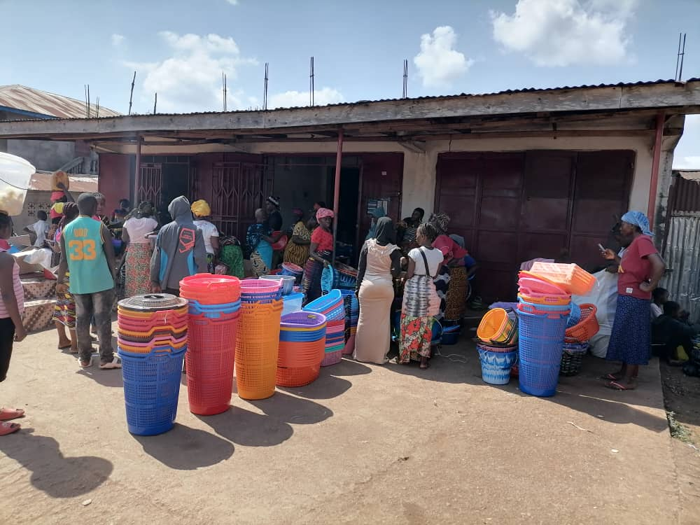
Findings: Land Border cont’d
Traders face challenges at checkpoints when moving their goods to their destination as their names are not on the bill of laden
The depreciation of the NLe is having an adverse impact on cross-border trade
Main imports are mainly rubber products, paper products, shelled and unshelled groundnuts
On average, the value of groupage imports/trader is about NLe 70,000 (approx. US$ 3,800 at today’s value)
Operationalisation of the scanner will ease the process of import valuation

Slide 15
Benchmark exercise – Ghana and Nigeria
Ghana
12.5 percent VAT charge on all imports (including groupage imports)
GST registration threshold US$ 20,000 (NLe 368,000)
Nigeria
7.5 percent VAT charge on all imports
GST registration threshold is US$ 70,000 (NLe 1,288,000)
Sierra Leone
Import GST 15% of import value
GST registration threshold NLe 100,000 (US$ 5,434.8)

Slide 16
Recommendations and Next Steps
Revision of the GST registration threshold
NRA to simplify the declaration process to enable informal groupage importers to have their names on the bill of lading (especially at the Port)
Discuss the GST process for small and medium enterprises shipping through the informal groupage system
Operationalisation of the scanner machine at Gbalamuya
Engagement with stakeholders to agree on appropriate GST computation for all forms of groupage

Slide 17
Thank You

