Slide 1

Benefit Incidence Analysis
for Education and Health
in Sierra Leone
(Who Benefits the Most from Government Spending on Education and Health?)
Sierra Leone Tax for Development Conference
organised by the International Centre for Tax and Development (ICTD) and Budget Advocacy Network
Dr. Yakama Manty Jones
December 2022
(Collaborative studies conducted by the Research and Delivery Division of the Ministry of Finance and the Expenditure Policy Division of the IMF’s Fiscal Affairs Department)

Slide 2
Outline
1
Country Context
Motivation
Benefit Incidence Analysis (BIA) Explained
Methodology-Education BIA
Key Findings- Education BIA
Methodology- Health BIA
Key Findings- Health BIA
Recommendations
2
3
4
5
6
7
8

Slide 3
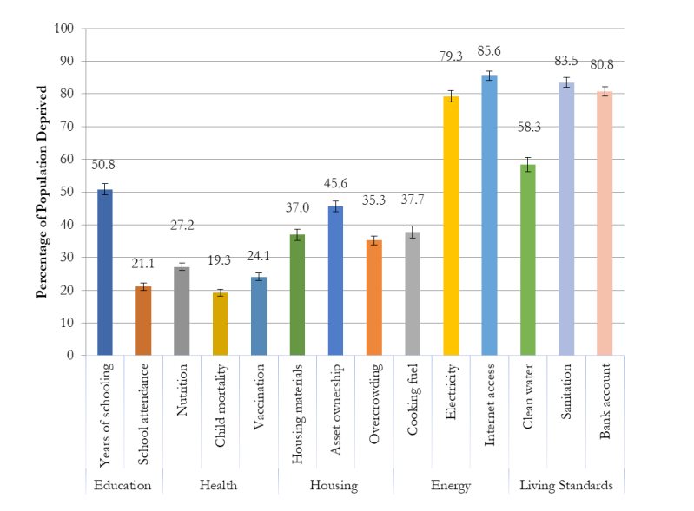
Country Context
Multi-dimensional Poverty (2019)
The Government of Sierra Leone has demonstrated increased commitment to human capital development through its Medium- Term National Development Plan
Budget allocation to the education sector has increased remarkably reaching 22 percent in the 2022 budget. Budget allocation to the health sector has also increased progressively.
Multi-dimensional poverty remains high at 64.8 percent in 2019. Performance on the Human Capital Index for 2020 only 0.36, reflecting the need for continued investments in human capital development
Financial resource constraints are prevalent on both the domestic and international levels.

Slide 4


Motivation
Why do we need to examine the distributional aspects of Government spending in education and health care?
Human capital accumulation is a fundamental driver of economic growth and of individual opportunities
The productivity of a country’s population is significantly influenced by the quality of education and health care it can access
Household income is a key determinant of education and health investment
Government investment can reduce ‘out of pocket’ education and health expenses for households thereby decreasing inequality and increasing social mobility
However, this expected impact depends on how Government spending on education and health is distributed across income groups
Benefit incidence analysis (BIA) is an important tool for evaluating how successful governments are at expanding access to services across income groups

Slide 5
Benefit Incidence Analysis (BIA) Explained
1
The Benefit incidence analysis (BIA) methodology is used to assess the distributional impact of public spending as a result of the combined outcome of Government and household decisions
2
It combines information on public spending with household survey data on who uses public services or receives public benefits.
3
Average BIA tells us about the distribution of public spending at a given point in time. Showing who the beneficiaries of current government spending are.
4
Average BIA does not tell us how this distribution has changed or how it is likely to change in response to policies
Marginal BIA attempts to overcome this limitation by estimating how the distribution of public spending is changing over time and who benefits from these changes
5
The BIA is a measurement exercise that focuses only on the distributional aspects of spending. It does not provide insights into what drives Government or household decision making.
6
BIA assumes that the costs of provision are a good approximation of the benefits that users (and society) attach to public services and does not directly address the quality of this spending in terms of generating human capital
7
8
This study uses data from the Sierra Leone Integrated Household Survey (SLIHS) for 2003 and 2018 and data on actual health and education expenditure.

Slide 6
Methodology- Education BIA
Step 1
Group population into welfare groups ( from poorest to richest) using a measure of welfare - consumption expenditure based on the SLIHS data
Step 2
Obtain the eligible population and number of individuals attending public schools by welfare group for each level of education (primary, JSS and SSS)
Step 3
Obtain the value of the economic benefit (the average unit cost of service provision)
We did not have data on unit cost for education in Sierra Leone, so we did our analysis by the level of education and assumed the unit cost is the same for all students
Step 4
Derive the distribution of benefits across groups
Step 5
Compare the resulting distribution of benefits with several distribution benchmarks in order to have a better sense of whether government spending is pro-poor or progressive
However, this is a simplified BIA exercise so steps 3 and 5 were not done

Slide 7
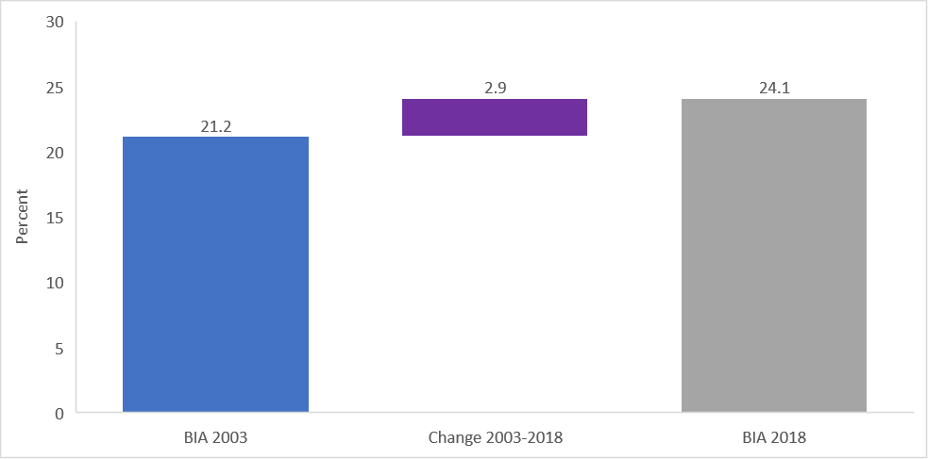
Education BIA -Key Findings (1/4)
Primary education
Average BIA for primary school education
Marginal BIA for primary school education – Poorest Quintile
The share of spending received by the lower welfare quintiles increased as more resources shifted from richer quintiles
Spending on public primary education spending has become increasingly more progressive or pro-poor over time
The marginal BIA shows an improvement in the share of sending received by the poorest quintile
In 2003, the poorest quintile received around 21 percent of the total spending on primary education, and this share increased to 24 percent in 2018

Slide 8
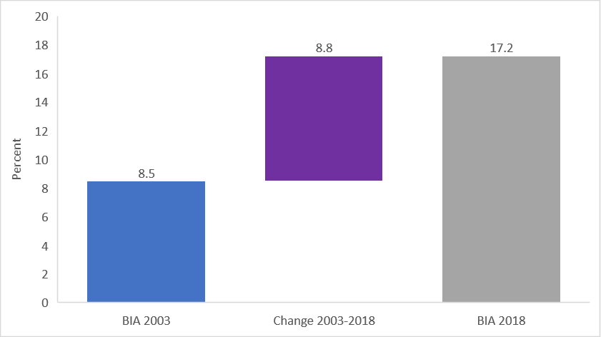
Education BIA -Key Findings (2/4)
Junior Secondary School (JSS)
Average BIA for JSS
Marginal BIA for JSS – Poorest Quintile
The incidence of government spending on JSS has been increasingly progressive over time, as spending was clearly pro-rich in 2003, but almost neutral in 2018
More resources have now shifted from the richer to the poorer quintiles
The change in average BIA in the poorest quintile for the period 2003-2018 is 8.8 percentage points
This represents a much larger change for the poorest quintile compared to what we saw for primary education

Slide 9
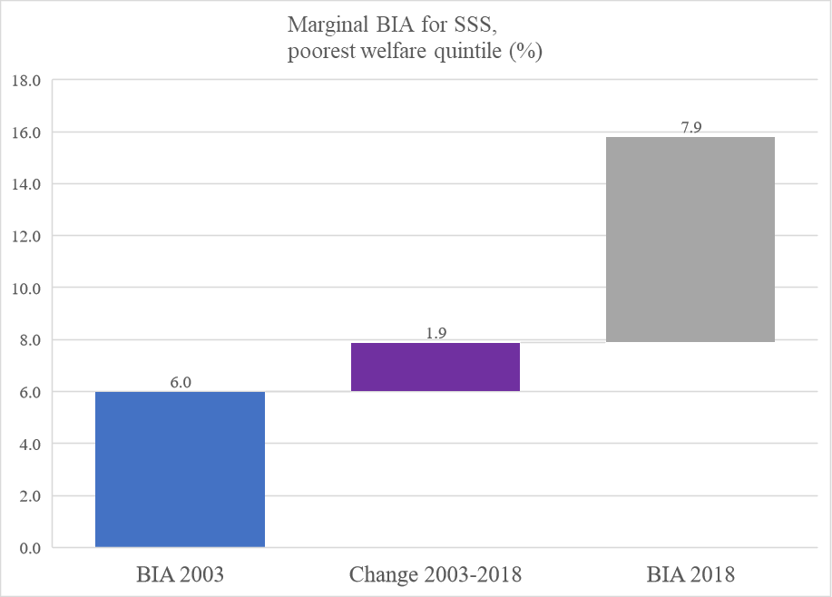
Senior Secondary School (SSS)
Education BIA -Key Findings (3/4)
Average BIA for SSS
Marginal BIA for SSS – Poorest Quintile
The distribution of government spending for SSS became significantly less regressive over the period of 2003-2018, as more resources shifted from the richest to the middle quintiles (Q2, Q3 and Q4)
The increment in the share of government spending on the poorest quintile is quite small compared to the changes for primary (2.9 percentage points) and JSS (8.8 percentage points) education
SSS spending is not as pro-poor as primary or JSS educational spending

Slide 10
Education BIA -Key Findings (4/4)
Barriers to Accessing Education in Sierra Leone
Many children drop out of school because of financial reasons. Across all educational levels, the share of children that quit schooling due to such reasons is highest for those in primary schools belonging to the poorest welfare quintile. School fees and tuition are the main expenditure components for all welfare quintiles
There is a seeming lack of appreciation of the value of education, as there is a high share of households citing this reason for their children leaving school.
Distance to school affects children across all welfare quintiles but appears to be more of a challenge for the poorest at the JSS and SSS levels. Distance to school as a barrier to schooling is more prominent in rural than urban areas.
For both the poorest and richest welfare quintiles, early marriage and teenage pregnancy hinder school attendance, especially for teenagers at the SSS level. Many households also cite illness as a reason why children leave school across the primary, JSS and SSS stages in all geographic regions of the country.

Slide 11
Methodology- Health BIA (1/2)
Step 1
Group population into welfare groups ( from poorest to richest) using per capita expenditure
Step 2
Estimate the utilization of different health services (i.e. inpatient care and outpatient care) by type of provider (i.e. public clinics and hospitals) for each group
Step 3
Compute the unit cost (expenditure divided by utilization) of each type of service and provider
Monetized health service benefits (subsidies)
Step 4
Multiply unit costs by the utilization of each type of service and provider for each group
Step 5
Subtract direct user fees or out-of-pocket payments for each type of service and provider for each group
Step 6
Aggregate subsidies for each group and compare the distribution of subsidies across groups

Slide 12
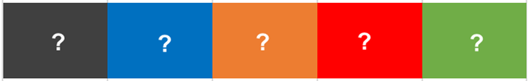
Methodology- Health BIA (2/2)
Quintiles from poorest to richest using per capita expenditure
Monetized health service benefits (subsidies)
Distribution of health service benefits (subsidies) by quintiles
?
?
?
Public inpatient
Hospital services
Public outpatient
PHC services
Hospital services
NHA data and utilization data from the SLIHS
Health service utilization data from the SLIHS
+
NHA means National Health Accounts SLIHS means Sierra Leone Integrated Housing Survey, 2018

Slide 13
Health BIA -Key Findings (1/3)
Poorer groups receive more subsidies by using public PHC services
Richer groups receive more benefits for using public hospital services (inpatient and outpatient)
Overall, the monetary value of benefits received by the poorest quintile (Le 37.6 billion) is lesser than the share enjoyed by the richest quintile (Le 62.6 billion)
Distribution of subsidies (Millions of Le) (SLIHS 2018)
Share of subsidies received by each quintile

Slide 14
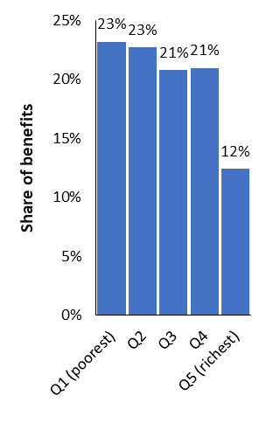
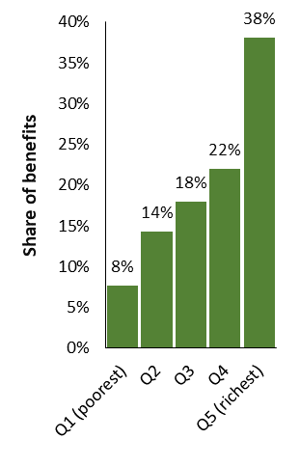
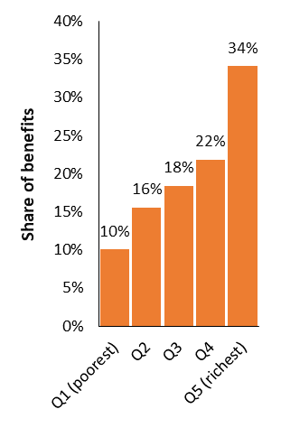
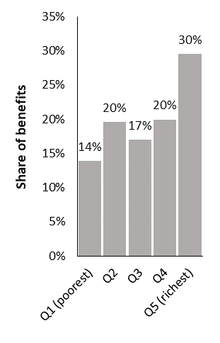
Health BIA -Key Findings (2/4)
Share of subsidies received by different quintiles (SLIHS, 2018)
Outpatient health services
Inpatient services
Public PHC services
Poorest 20% benefit more than the richest 20% of the population
Public hospital services
Richest 20% benefit more than the poorest 20% of the population
All public health services
Richest 20% benefit more than the poorest 20% of the population
Public hospital services
Richest 20% benefit more than the poorest 20% of the population

Slide 15
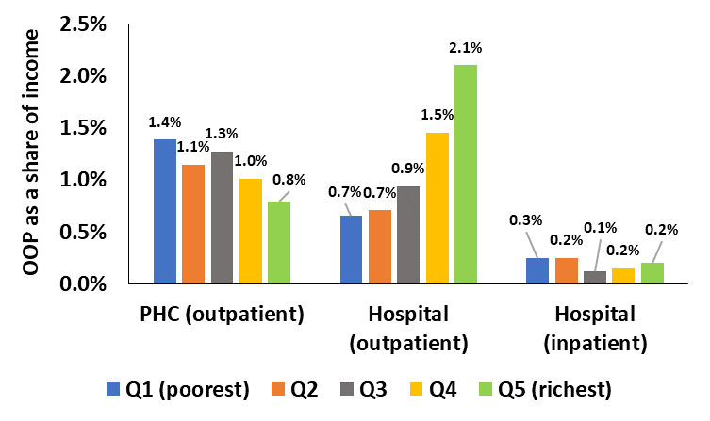
Health BIA -Key Findings (3/4)
Who pays out-of-pocket (OOP) for public health services in Sierra Leone?
Public PHC services
Poorer groups bear a disproportionately higher burden: they pay more as a proportion of their income than richer groups
Public hospital services
Outpatient:
Burden higher among richer groups
Public hospital services
Inpatient:
Poorer groups bear a higher burden of financing these services out-of-pocket than richer groups

Slide 16
Recommendations- Education BIA
 | Strategic recommendation | Policy Reccomendations
1 | Improve the education data generation process for targeting of education expenditure | Direct education resources to mostly poverty-stricken areas and households
 |  | The GoSL, through Stats SL, should conduct national surveys to allow for poverty mapping and targeting
2 | Improve the effectiveness of teaching and learning to improve education outcomes | Strengthen teacher training; reinforce teacher monitoring and management; keep children in schools
 |  | Demand increased accountability from school authorities
 |  | Strengthen cooperation between the MBSSE, TSC, Local Councils, School Boards, and School Management Committees
3 | Utilise a data-driven and cross sectoral approach to education development | Scale up the use of the education management information system (EMIS) to identify areas where school attendance and performance are below set targets
4 | Mobilise resources to expand access to quality education | Raise more resources; broaden the tax base to create more fiscal space, and build the capacity of Local Councils to generate revenues which can be utilised to support the education sector
 |  | Undertake a mapping of the needed resources and international financing into the Medium Term Revenue Strategy
5 | Strengthen cooperation and partnerships to support the education sector | Continue cooperation with Development Partners, international NGOs, the private sector, missions providing educational services, and also Local Councils could strengthen the platform already created to expand access to education and reduce the shortfalls in NERs and GERs.

Slide 17
Recommendations- Health BIA
 | Policy Recommendations
1 | Increase resource allocation to primary health care (PHC) as the poor benefit more from this layer
2 | Resources/subsidies to public hospitals should be better targeted to ensure the poorest access healthcare services
3 | Reduce donor dependency on aid (implementation of Internally Generated Revenue (IGR) at the hospital level and strengthen District Councils in the collection of revenue)
4 | Reduce OOP for households accessing PHC service utilization (implementation of Sierra Leone Social Health Insurance -SLeSHI)
5 | To ensure equity, resources must be distributed using a needs-based allocation formula. Adequate demographic, health, social, administrative and related data must be available to inform the basis of setting the formula
6 | Make resource allocation more effective | Conduct a needs assessment before allocations are made Allocate resources based on needs to programmes/interventions that yield the greatest outcome Scale up monitoring and evaluation (M&E) Introduce performance-based financing (allocate resources based on workload and high performance)
7 | Implement the Sierra Leone Health Financing Strategy
8 | Invest in digitalization of health information systems and integration to support needs assessment, monitoring and credible data

Slide 18
Thank you for listening.

