Slide 1
PRESENTATION
FAIR TAX MONITOR STUDY FOR SIERRA LEONE
ActionAid, Sierra Leone
Aminata Kelly-Lamin, Policy and Advocacy Manager
Sierra Leone Tax for Development Conference
8th December 2022

Slide 2
Outline
Why We did the study
How We did it
What We Found
Implications: Policy Makers, Civil society
Next Steps

Slide 3
WHY WE Did It
Taxation is the main means by which a government finances its expenditure.
Sierra Leone planned to spend approximately US8.15 billion to meet its development articulated in Mid-Term National Development Plan (MTNDP) 2019-2023. The only sustainable way of financing such expenditures is through taxation.
Taxation is also the cornerstone of the social contract between state and citizens– quality gender-responsive public services provided by the state in exchange for taxes paid – and therefore, a vital path to building legitimacy and a sense of fairness
The tax system referred to should be based on principles of transparency, accountability and participation. A regressive tax system though may be fair because it is applied to everyone may tend to place greater burden on especially the poor compared to high-income earners

Slide 4
WHY WE DID IT
Studies by research institutions (OECD, 2013; ECA, 2018) revealed that discretionary tax expenditures and other tax waivers embedded in agreements of mining companies granted by governments and derogations, particularly in resource-rich countries continue to erode the country’s tax base. Sierra Leone is no exception.
Other challenges that affect the feasibility of raising taxes and other revenue include widespread poverty and illiteracy; hard-to-tax groups in subsistence agriculture and the informal sector; problematic accounting in the private sector; deficient rule of law and a high incidence of corruption; and weak administrative capacity.
AASL and CSOs through the Tax Movement Sierra Leone working on Taxation decided to commission the first FTM evaluation in Sierra Leone.

Slide 5
How We Did It
The goal of the study - To contribute to a better understanding of tax issues in Sierra Leone and to provide a firm basis for both civic education and advocacy campaigns to promote a fairer tax system.
The specific and target-oriented objectives:
Provide a detailed review of Sierra Leone’s tax system and expenditure on public services based on the FTM methodology.
Provide strong evidence-based support for country-level advocacy, campaigns and influencing work.
Create a framework to compare the tax systems of selected countries over time and measure changes in tax policy in Sierra Leone.

Slide 6
How We Did It
The CRF is divided into 6 thematic categories used for evaluation.
These categories are meant to cover the main issues that tax systems in developing countries face today and to reflect the idea of a fair tax system.
The categories included in the FTM’s methodology to evaluate the tax systems are:
  Progressive tax system
  Sufficient revenues
  Tax competition and corporate tax incentives
  Effective tax administration
  Pro-poor Government spending
  Accountable public finances
In terms of scope, the FTM study for Sierra Leone focused on the first 3 categories covering a 5 years period (2015 – 2019).
The study relied more on secondary data and expert opinion (NRA, RTPD of MoF and selected Medium to large taxpayers).

Slide 7
How We Did It
Each category is divided into several sub-categories for which a series of scoring questions are designed, the relevance of the question in relation to fair taxation and some tips in answering the question.
The scoring questions were formulated as binary (yes/no) questions and their structure is adjusted so that a scoring point is assigned to a positive answer and no scoring point to a negative answer.
For qualitative questions, to indicate a country scores partially positive, the methodology offer the possibility to give 0,5 points. In this way, it is possible to work with both qualitative and quantitative data and to combine them in constructing the final score for each category.
The scoring scale is defined from 0 to 10; 0 representing an unfair component of a tax system and 10 representing a fair component of a tax system.
The final scores are rounded up for practical purposes, but the exact scores are available in the methodology sheets.
The scale is also divided into 5 coloured intervals corresponding to scores (0 to 2), (3 to 4), (5 to 6), (7 to 8) and (9 to 10).
Summary of the subcategories across the 3 broad categories is presented in the table in the next slide.

Slide 8
Progressive tax system | Sufficient revenues | Tax competition and corporate tax incentives
Cross-cutting progressivity | Sufficiency | Governance
Personal Income Tax (PIT) | Illicit financial flows | Transparency
Corporate Income Tax (CIT) | Tax revenues
Wealth Tax | Non-tax revenues
VAT/Sales Tax/GST | Taxpayers
Presumptive/turnover tax (informal economy taxes)

Slide 9

What we Found
Summary Findings
The figure below gives the summary result of the Fair Tax Monitor Index. The figure shows that Sierra Leone’s overall tax system is moderately progressive and sufficient, with somewhat unfair competition in the tax system.

Slide 10
What we Found
On Distribution of the Tax Burden and Progressivity
The research found that Indirect taxes (which are generally less progressive) contributed marginally higher 45.1 %, as compared to Direct taxes at 37.9% and non-tax revenue 17%, between the period 2015 -2019(which are generally more progressive) and non-tax revenue 17%, between the period 2015 -2019.
The main direct taxes in Sierra Leone are Personal Income Tax (PIT) (28.8%) and Corporate Income Tax (CIT) 9%, PIT is collected from only 0.03% of the country’s population from a projected 0.14%, and CIT is hampered by income tax incentives given to some mining and agricultural investments and potentially by inadequate rules for transfer pricing and thin capitalization.
Women face a higher tax burden considering that they earn way less and generally are less wealthy than male compatriots in the economy. Despite government policies being clear on gender equality, interestingly, the survey reported that for households that pay personal income tax, female-headed and female-dominant households pay a larger proportion of tax relative to household income.

Slide 11
Findings
Although steps have been taken to develop legislation relating to transfer pricing and thin capitalization, it is questionable if current rules such as the demand dividend rule and authority given to the CG to reverse transactions classified to lead to tax avoidance are adequate. There is no evidence whatsoever that the Commissioner-General has used such powers. Enactment by Parliament of this regulation will help address problems of transfer pricing.
Revenue Sufficiency and Tax Leakages
In terms of sufficiency, Sierra Leone has recorded a significant and steady increase in domestic revenues (direct taxes, indirect taxes, and non-tax revenues) over the years (2015-2019).
Domestic revenues increased in nominal terms by 130.8% to Le5.39 trillion in 2019 from Le2.33 trillion in 2015. On average, the Government was able to collect about 95.6% of its budgeted revenues for the period under review (2015-2019).
However, the tax system is less sufficient because the country is not free from chronically high debt and the tax to Gross Domestic Product Ratio (10.4%) is less than the least developing country’s average of 13%.

Slide 12
What We Found
In Sierra Leone, inflows and outflows estimated from import mis-invoicing and export mis-invoicing stood at US$132 million and US$572 million respectively in 2015 (Global Financial Integrity, 2019).
Despite concerns about tax revenue leakage in the mining sector, the GoSL is yet to take action to safeguard its tax base. Comprehensive legal and administrative reform is urgently required if Sierra Leone is to combat tax avoidance and secure its fair share of resource rents.
To combat IFFs, corruption and to recover stolen assets, the country has enacted subsequent Anti-Corruption Acts (2000 and 2008), the latest was its amendment in 2019. Also, enactment of the Anti-Money Laundering and Combating of Financing of Terrorism Act 2012.
Notes:
Notes: n June 18, 2019, the ACC presented a cheque of Le7.5 billion (US$750,000) to H.E the President of the Republic of Sierra Leone, Dr. Julius Maada Bio as part of a whooping Le16 billion (US$1.6 million) of stolen cash recovered from corrupt officials

Slide 13
What We Found
Competition and Corporate Incentives
Sierra Leone offers several tax incentives across different sectors, extended to several exemptions on selected tax handles such as GST, Withholding Tax (WHT) and import duties.
As much the tax forgone from exemptions and incentives from import duty and GST is published, corporate tax incentives and their impact is not monitored on a yearly basis by the government.
Data on the opportunity costs and benefits of the income tax incentives are unavailable. Incentives lead to massive losses to potential government revenue and hence should be informed by cost-benefit analysis. In cases where incentives are redundant, they should be scrapped.
The tax system is somewhat less competitive as per the Fair Tax Monitor assessment. Despite, there being clear and transparent rules for granting corporate tax incentives, uniformity of incentives is a problem for corporation tax. Waivers are granted to some companies articulated in mining agreements. Notwithstanding, the enactment of the Extractive Industry Revenue Act (EIRA) of 2018 tends to solve this problem.

Slide 14
What We Found
The tax rates for small and micro businesses range from 2% to 6%. This is among the highest in Africa, and has a significant impact on the survival of small and Micro businesses.
Tax policy changes targeting formalisation could have been made for only the purposes of generating revenue while impacting business survival.

Slide 15
Implications of our work
Government
Speed up the automation of tax collection processes and procedures through the implementation of Information Technology Systems including Integrated Tariff Analysis system (ITAS) and ASYCUDA World.
The MoF and the NRA should strongly think of putting together a framework to quantify the size of tax incentives and exemptions in Sierra Leone. The outcome would inform the Government of the quantum of lost revenues, which will guide the appropriate policy measure to curtain incentives and exemptions.
Government also needs to speed up the full-blow execution implementation and enforcement of the regulation on transfer pricing and thin capitalization. There is high risk of revenue loss while clear legislation on these is yet to be enforced.
Government to pay attention to implementing its tax policies as articulated in the 2019 and subsequent budget speeches especially the tax policy relating to eliminating duty and tax waivers/exemptions for contracts awarded by Ministries, Departments and Agencies (MDAs) for the supply of goods, services and works. Addressing this will increase tax revenue/GDP ratio by 0.9%.

Slide 16
Implications of our work
It is quite evident from studies that there is a knowledge gap on types of taxes administered by NRA and rates paid by taxpayers including when and how taxes should be paid. There is a need to double efforts in simplifying the existing tax laws and policies, where applicable in local languages, including simplification of the budget speeches that dictate annually the revenue measures to be implemented to boost the revenue profile of the Government
In other to strengthen tax compliance, the Government through NRA should further strengthen the existing aggressive nationwide taxpayer education and sensitization programme and putting a robust taxpayer assistance strategy for SMEs; strengthen the field audit of large taxpayers and conduct special audits on the mining and telecommunications sectors; pursuing the establishment of a tax court to prosecute tax defaulters; and to build systems for the effective taxation of professionals (lawyers, doctors, accountants and engineers. One way to do this is to ensure renewal of practice licenses is pre-conditioned to obtaining a Tax Clearance Certificate from NRA as implemented in other African countries like Uganda.
Implementation of the points-based system of property taxation should be improved upon to determine rates in a way that will mimic the true market value of properties.
Given that female-headed and female-dominant households pay a larger proportion of tax relative to household income, there is a need to provide specific tax exemptions on specific business activities dominated by women

Slide 17
CSOs and Non-State Actors
There is a need to build public awareness of their constitutional duty to pay taxes and influence government affairs (including demanding quality public services). Citizens need to understand that as taxpayers they can make their voices heard and actively take part in public policy decision-making processes about how taxes are collected and spent on public services and hold governments accountable.
There is a need for more advocacy work by CSOs and NSAs in ensuring tax administration by the government is transparent and accountable.
To make effective engagement on tax policies, there is a need to undertake more empirical studies (evidence-based) to determine how equitable and efficient the tax system is and the impact of taxes on various categories of people.

Slide 18
Next Steps
Launched the Report and disseminated it widely through the media.
Shared report with relevant institutions (NRA and MOF) and lobbied for the implementation of the recommendations.
Share the report for use by the University of SL – IPAM to be specific.
Continue to engage the Government with the TMSL and other like-minded institutions for the implementation of the recommendations.
Use other platforms like budget process and the EITI to influence government actions on the
Monitor the implementations of Recommendations and share the findings.
With funding, we will conduct another FTM study covering the 6 categories of the framework.

Slide 19
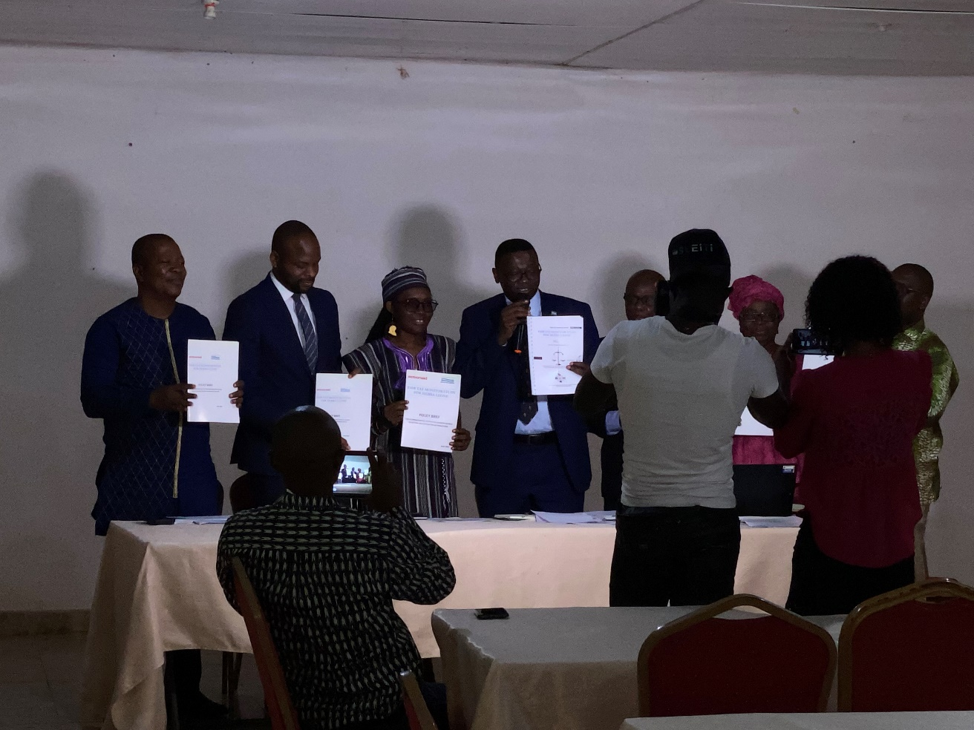
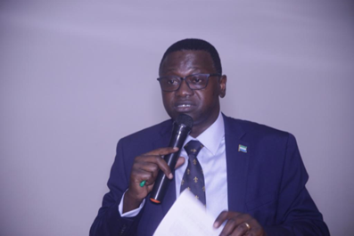
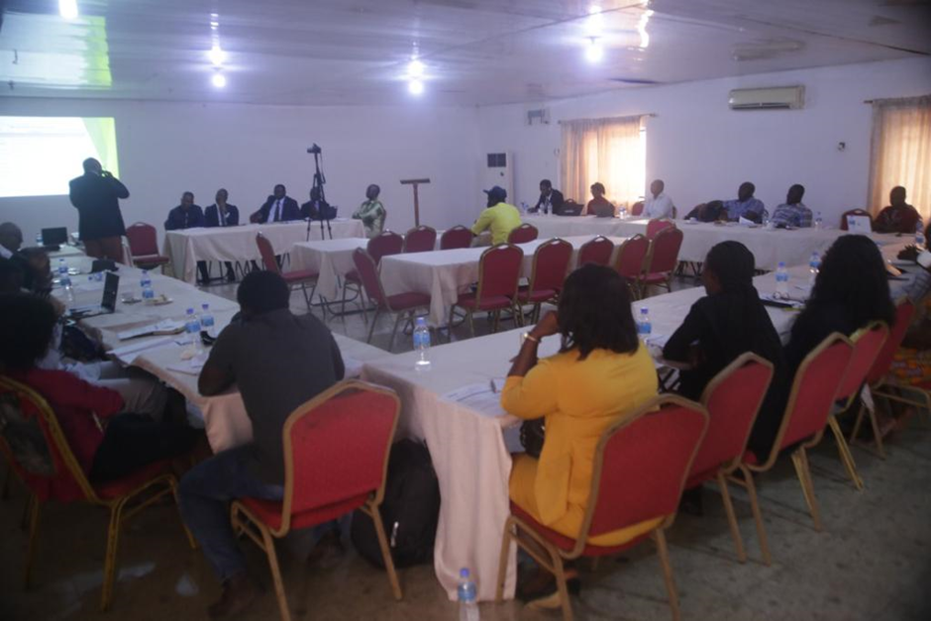

Slide 20
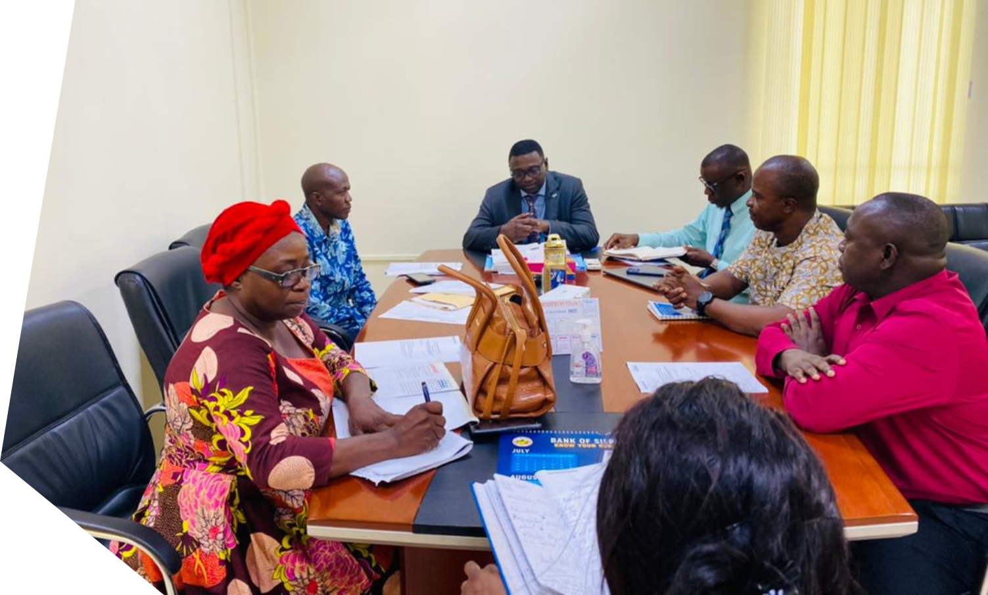
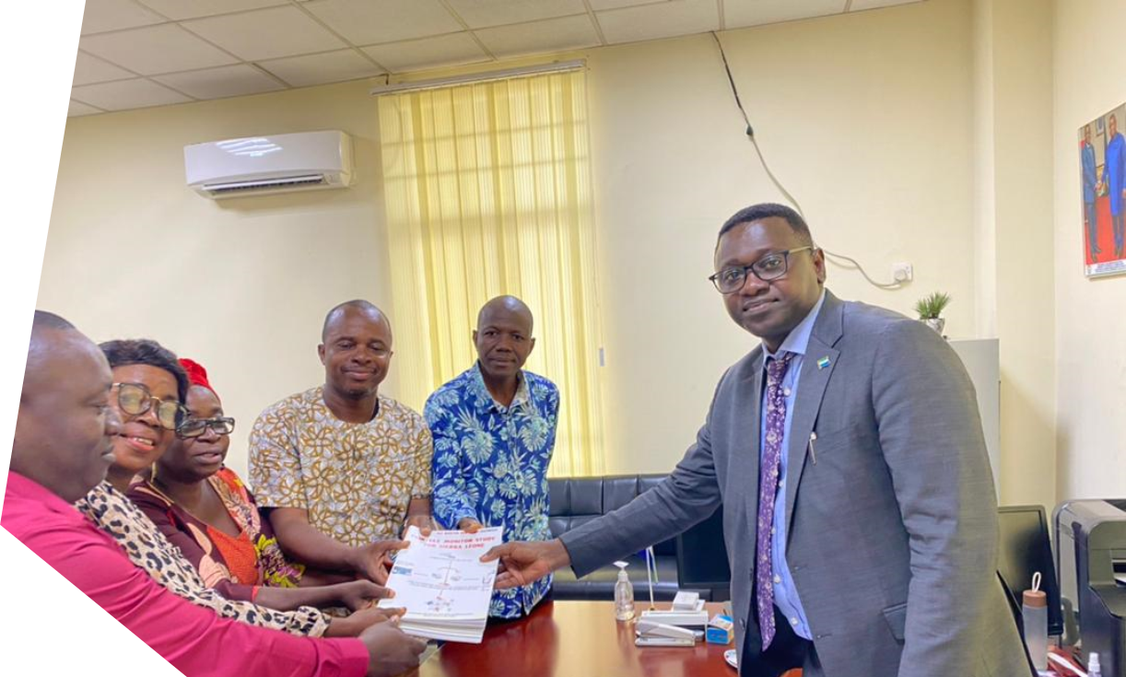
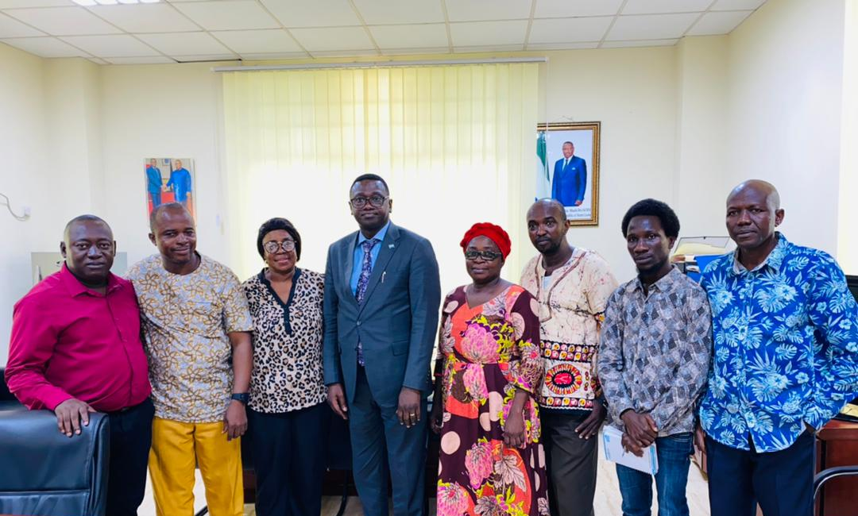
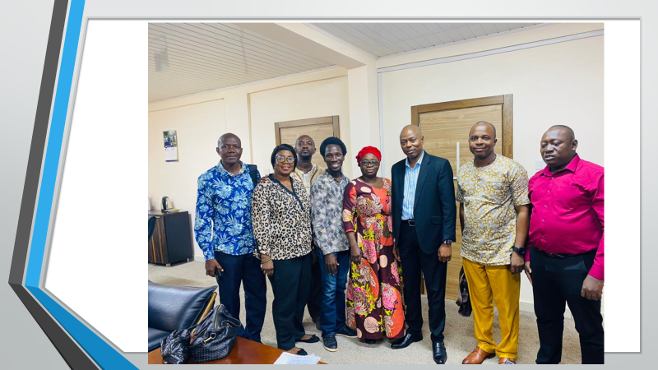

Slide 21
