Slide 1
Supporting more meaningful tax transparency and taxpayer engagement in Sierra Leone
Vanessa van den Boogaard, Wilson Prichard, Rachel Beach, and Fariya Mohiuddin

Slide 2
How can the links between taxation and accountability be strengthened?
Improved transparency and taxpayer services
A robust and engaged civil society
Forums for taxpayer-government engagement

Slide 3
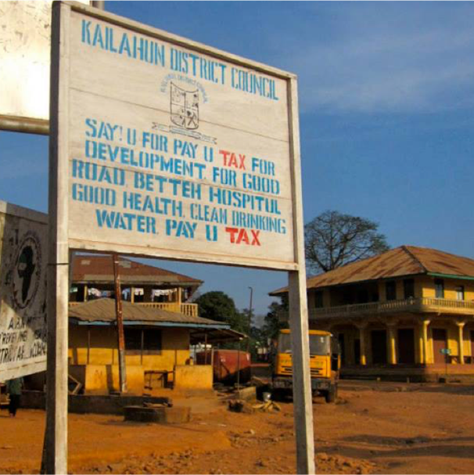
The state of tax transparency and taxpayer engagement
Low taxpayer knowledge:
76% of respondents said it was difficult to find out how the central govt spends public revenues
Low trust, lack of knowledge → limited willingness to engage
91% believed there was no chance at all of influencing an unjust central govt tax policy

Slide 4
How to support meaningful tax transparency
Share information that addresses taxpayers’ key concerns (how revenue is spent)
Share information through radio
Use interactive channels of communication (i.e. call-in radio shows)

Slide 5
How to strengthen taxpayer engagement
Demonstrate responsiveness
Engage trusted community allies
Support civil society actors as translators, enablers, and trainers
Tailor approaches for traditionally marginalized groups

Slide 6
Read more about strengthening tax transparency and taxpayer engagement

Slide 7
Thank you!
Vanessa van den Boogaard
@VVandenboogaard www.VanessaVanDenBoogaard.com

