Slide 1
The politics of taxation and tax reform in time of crisis:
Covid-19 and attitudes towards taxation in Sierra Leone
Orgeira Pillai, van den Boogaard and Prichard, forthcoming
Notes:
(30 seconds) Today, I will be presenting a descriptive analysis of the impacts of covid-19 on attitudes towards taxation, and to unpack what the crisis reveals about the dynamics and politics of taxation more broadly. The forthcoming resulting paper was collaboratively written by Vanessa, Dr. Wilson Prichard and myself.

Slide 2
Taxpayer attitudes in periods of crisis
Significant fiscal impact of Covid-19
Increases in expenditures to finance health systems
Decreases in tax revenue
Two possible impact of the pandemic on taxpayer attitudes
Catalysts for major expansions of taxation (including progressive taxation) or
Resistance to tax demands due to economic hardship
Notes:
(2min) The Covid-19 pandemic has had significant fiscal implications around the world, with substantial increases in expenditures to finance health systems and social protection, coupled with large decreases in tax revenue resulting from the economic slowdown. In low-income countries, the fiscal situation is particularly pressing, given relatively weak fiscal foundations, limited borrowing options, and decreases of foreign aid as a result of the pandemic.
Against the background of significant fiscal challenges, a key question facing governments is whether and how the pandemic has shaped taxpayer attitude, and what that means for the prospects for tax reform and new revenue raising in the wake of the pandemic. In seeking to answer that question, we are presented with two sharply contrasting potential outcomes. On one hand, periods of crisis have sometimes acted as catalysts for major expansions of taxation, and of more progressive forms of taxation in particular. This reflects the fact that crises have the potential to generate new political space for reform, as they often increase pressure on governments to increase revenue, while simultaneously driving greater public acceptance of taxation. On the other hand, amidst economic hardship, taxpayers may become progressively more resistant to tax demands. Both dynamics appear potentially relevant in the case of the Covid-19 pandemic, which has sparked sharp new revenue pressures and economic hardship, particularly in lower-income countries.

Slide 3
High frequency phone interviews
Builds on two existing sampling surveys:
First survey in Freetown (Feb 2020), included questions about attitudes toward taxation
Second survey in the provinces, to study the impact of electrification on welfare
Responses averaged over four critical time periods:
Round 1 (during: May-July 2020): appearance of Covid
Round 2 (during: Aug-Oct 2020): until the end of government restrictions
Round 3 (post: Nov 2020-Jan 2021): period after the restrictions were lifted
Round 4 (during: Feb 2021): new curfews and inter-district ban
466 Freetown respondents and 233 respondents from the provinces were interviewed at least once in each of the periods
Notes:
(2min) In this study, we aim to understand the impacts of the Covid-19 pandemic on attitudes toward taxation and, in turn, to unpack what the crisis reveals about the dynamics and politics of taxation more broadly. We build on two existing sampling frames in the country – one across the entire country, the other specifically of property owners in Freetown. And we conducted regular phone surveys beginning shortly after the onset of the pandemic and continuing for almost a year. Most critically, we are able to build on a baseline survey in Freetown conducted shortly before the onset of the pandemic, which contained explicit questions about attitudes toward taxation, and thus allows us to directly compare attitudes before and after the beginning of the pandemic.
Data was collected over the phone periodically, with respondents called every month or every six weeks, and targeted heads of households or individuals who were most knowledgeable about household affairs. We averaged responses by respondent, over four critical time periods:
The first three months of COVID
The next three months until the end of government restrictions
After restrictions were lifted, and finally
When new curfews were imposed
As we collected data at a high frequency, the survey instrument was designed to be short to minimize respondent fatigue and to increase data quality. The tax-related section, representing about a quarter of the survey length, included questions about formal taxes, user fees and informal contributions during Covid-19 and other tax-related measures .

Slide 4
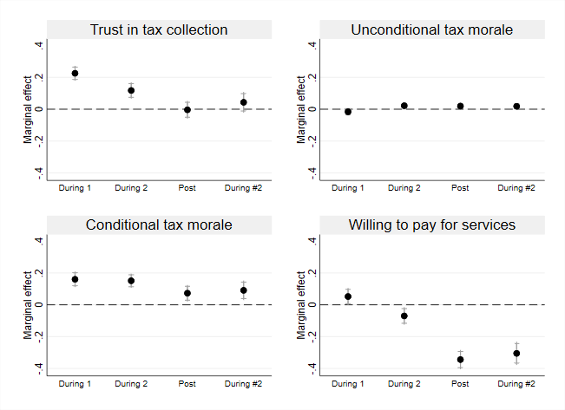
Key findings
Steady support for general taxation
High levels of unconditional tax morale (government’s right to tax) and increased trust in the fairness of the tax system after the onset of the pandemic
Increased conditional attitudes towards taxation
Increased conditional tax morale – tax compliance conditional on reciprocal delivery of benefits by the government
Notes:
(2min) First, we ask how attitudes toward the government and taxation changed between the pre-pandemic period and the period after the onset of the pandemic. In this graph, the referred dotted line at zero allows to distinguish any significant changes between a given period and levels pre-covid in Freetown.
We see steady support for general taxation, here labelled as Unconditional tax morale, immediately after the onset of the crisis. Despite escalating economic challenges, close to 100% of respondents agreeing that citizens should always pay taxes. Sustaining this high level of support, despite the pandemic, can correspondingly be taken as a strong signal of sustained support for tax compliance. This message is reinforced by responses about trust in tax collection, with a very large and significant increase in reported trust in the fairness of the tax system immediately after the onset of the pandemic.
However, we also see taxpayers express increasingly conditional attitudes toward taxation; that is, at the same time that they show general support for taxation they become more likely to believe that one could refuse to pay taxes if government fails to deliver services in return. Taken in together with sustained general support for taxation, this suggests a shift in the character of the relationship between taxpayers and the state, in the wake of the pandemic. That is, in response to the pandemic, taxpayers appear to experience a sustained high level of general support for taxation, consistent with narratives of social solidarity in response to crisis, but that support for taxation becomes more conditional on government performance. This shift is consistent with taxpayers, confronted with both acute societal needs and significant economic pressures, becoming more focused on the responsibility of government to deliver concrete benefits with public revenue – and, perhaps, also becoming more aware of failures to do so.

Slide 5
Key findings
Support for taxation erodes over time
Support for general taxation remains high while we observe a decrease in perceived fairness in the tax system and taxpayer’s willingness to pay additional taxes to receive greater services
Rising and sustained support for progressive taxation
Among different funding options to fund the Covid response, increased taxes from the richest and large businesses gained the most support
Notes:
(2min) Having captured a snapshot of changes in attitudes in response to the onset of the pandemic, we then explore the evolution of taxpayer attitudes over the course of the pandemic. That evolution adds nuance to the initial story.
In Freetown support for the view that citizens should always pay taxes remains consistently very high throughout the pandemic, with no evidence of decline over time. By partial contrast, after witnessing a significant increase in trust in the tax system immediately after the onset of the pandemic in Freetown, we see levels of trust in the tax system return to baseline as the pandemic progresses.
We also observe a small increase in reported support for paying additional taxes in exchange for improved services immediately after the onset of the crisis. However, we see a substantial decline in willingness to pay additional taxes over the course of the pandemic. The most likely conclusion appears to be that the decline in support for paying additional taxes is a result of both economic hardship and some disappointment with government taxation.
Finally, in addition to shifting support for taxation, we explore taxpayer perceptions of various options for funding the recovery, in particular support for progressive taxation in response to the pandemic. In all survey rounds we asked taxpayers how they think that the government should fund the response to, and recovery from, the Covid-19 pandemic. Unsurprisingly, in times of economic crisis, reliance on external means of financing, including aid and loans, is the preferred option among respondents. Of greater interest, however, is clear evidence of sustained increases in support for progressive taxation, reflected in increasing support for taxing the rich and taxing large businesses.

Slide 6
Opportunity for tax reform
Shifts in views towards taxation..
Increased conditional attitudes towards tax compliance
Greater support for taxing the rich
… but fleeting over time
Window of opportunity for tax reform (including progressive tax reform) though public support rapidly dissipates.
Notes:
(2min) These findings have potentially significant implications for understanding both immediate responses to the pandemic, and the broader politics of taxation and tax reform. While there is some evidence of general increased support for taxation initially after the onset of the pandemic, a year later general support for taxation looks similar to the pre-pandemic period. Yet two shifts appear more durable. First, particularly in Freetown there appears to have been a sustained shift in the extent to which taxpayers hold conditional attitudes toward tax compliance, with increased expectations of effective service delivery using tax revenues. Second, we see a sustained shift toward greater support for taxing the better off and larger companies. This points toward the potential for a strategic focus on post-pandemic tax strategies that emphasize comparatively progressive taxes, and which seek explicitly to demonstrate clear connections between new tax revenues and expanded service delivery.
In line with evidence elsewhere that periods of crisis can spark expansion of taxation, we see evidence of the emergence of a political window of opportunity for tax reform – and progressive tax reform in particular – immediately following the onset of the pandemic. However, we equally see that that window of political opportunity was not unconditional: amidst economic challenges ,taxpayers appear to have been willing to support the collective good, but only if they saw evidence that tax revenues were being used to provide a meaningful response to the crisis. And in practice that window of opportunity appears to have been fleeting, as by the end of the pandemic, public support had largely dissipated – though with some lingering increase in support for taxing the better off.

