Slide 1
Latin America Tax Expenditure Research, Advocacy, and Learning (LATERAL) project
A case study by Paolo de Renzio for the International Budget Partnership
January 2019
Summarized by Soukayna Remmal

Slide 2
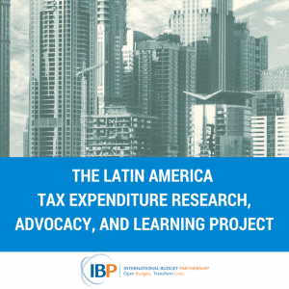
Outline
The International Budget Partnership and the Case Study
Tax Expenditures
Key Research Findings
Challenges and Opportunities
Conclusions

Slide 3
The International Budget Partnership
The International Budget Partnership is a global partnership of budget analysts, community organizers, and advocates working to advance public budget systems that work for people.
For over 20 years, IBP has worked hand-in-hand with partners in 120 countries to ensure everyone can understand, have a voice in, and track how public money is raised and spent.
IBP generates data, advocates for reform, and builds the skills and knowledge of people so that everyone can have a voice in budget decisions that impact their lives.

Slide 4
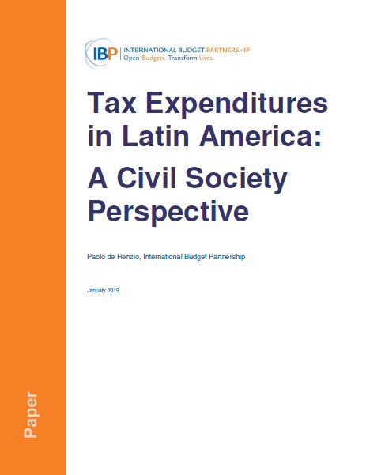
About this case study
This publication was developed as part of the Latin America Tax Expenditure Research, Advocacy, and Learning (LATERAL) project.
LATERAL is an innovative collaborative research, capacity-building, and advocacy initiative that was launched by the International Budget Partnership (IBP) and ten Latin American civil society organizations (CSOs) in 2016 to support CSO work on increasing the transparency, accountability and equity of tax expenditure policies at the country and regional levels.
The ten CSOs that did the primary research are based in the nine following countries : Argentina, Brazil, Colombia, Dominican Republic, Ecuador, El Salvador, Guatemala, Mexico, and Peru.

Slide 5
What are tax expenditures?
The IMF defines tax expenditures as “Revenue foregone, attributable to provisions in the tax law that allow special exclusions, exemptions, deductions, credits, concessions, preferential rates, or deferral of tax liabilities for select groups of taxpayers or specific activities. These exceptions may be regarded as alternatives to other policy instruments, such as spending or regulatory programs.”
(Fiscal Transparency Handbook, 2018)

Slide 6
Why do governments grant tax expenditures?
Governments use tax expenditures to pursue various objectives, including:
Making the tax system more progressive, by for example not charging Value Added Tax (VAT) on basic food items.
Stimulating (foreign) commercial investment in particular industries or locations, through any of a wide range partial or complete tax exemptions.
Encouraging savings and investment, by for example charging less tax on company profits that are reinvested or on interest earned on certain financial instruments.
Subsidising activities like the provision of health and education, or charitable and religious work more generally, by reducing taxes on donations and exempting charitable organisations from income or other taxes.

Slide 7
Controversies around tax expenditures
Tax expenditures matter because they are often big, amounting to a significant fraction of taxes actually collected.
In practice, the problems lie almost entirely with tax expenditures for investors (‘tax exemptions’).
These are often granted on a discretionary basis by Presidents and government ministers. Information about them often scarce.
Exemptions are often given to investors for political reasons or in return for bribes.
Exemptions are often ineffective in increasing or shaping investment.

Slide 8
Why should CSOs engage with tax expenditures and exemptions?
In many countries, tax expenditures considerably reduce tax collection and shift the burden of paying on to poorer people – without much benefitting the economy.
CSOs can leverage their skills and connections to unearth and publicise information about tax expenditures that governments either do not collect or prefer to suppress. International support and inspiration is generally available.
Because tax expenditures are so often granted to investors by violating either the law or public policy norms like transparency and consistency, CSOs can campaign with right on their side.
While they may find it difficult to understand or engage with many more technical tax policy issues, ordinary people are more likely to respond to revelations about unjustified, unfair and ineffective tax exemptions for large – and often foreign – companies.

Slide 9
Key research findings (1/5)
Three main categories of findings arise from the LATERAL study of tax expenditures in Latin America:
Issues of transparency and access to relevant information;
Issues related to decision-making processes around tax expenditures;
Issues around the impact of tax expenditures.

Slide 10
Key findings (2/5)
Issues of transparency and access to relevant information:
Government reports on tax expenditures do not provide sufficient information to allow for proper assessment and deliberation.
More justification is needed on the bases and rationale for tax expenditures.
More transparency would allow for proper democratic debate and deliberation on the adequacy and impact as of tax expenditures.

Slide 11
Key findings (3/5)
Decision-making processes:
Opacity: Tax expenditures constitute ad hoc exceptions to the tax code that are usually not examined as part of the regular budget process.
Opportunities for lobbying: decision-making around their design and approval is mostly opaque and prone to lobbying by powerful interest groups, including for big decisions about, for example, the period for which exemptions would be remain valid.

Slide 12
Key findings (4/5)
Evaluating the Impact of Tax Expenditures:
Evaluating the overall costs and benefits of tax expenditures to society in a complicated endeavor.
CSOs can collect some data, raise the issue, and try to ensure it gets to the policy agenda.
But evaluations adequate to form the basis of public policy decisions require detailed data and sophisticated analytic techniques. Government agencies need either to do the analysis themselves or provide the data in full to external analysts.

Slide 13
Key findings (5/5)
Cases of limited impact of tax expenditures:
In Colombia: the government itself recognized that empirical evidence showed that the effect of investor tax exemptions for zonas francas (free trade zones) were not as positive as expected.
In Central America: A regional study questioned the commonly held view that investor tax exemptions are key to attracting investment. It showed that the large investment incentives had little impact on economic growth or job creation.
In Mexico: a group working in the state of Sonora highlighted the contradiction inherent in that the same government that doles out investor tax exemptions to large scale agribusiness claims not to have sufficient resources to provide basic services for the poor.

Slide 14
Challenges and Opportunities (1/3)
 | Challenges | Opportunities
Transparency | Lack of data Differences in available makes comparisons difficult Secrecy is intentional | IBP will carry out a more comprehensive comparison of country practices on tax expenditure transparency, based on existing international guidelines “Tax Incentives Scorecard” (Christian Aid, ICEFI) provide a good template for comparison IBP and partners are planning a comparative study on tax secrecy practices across countries, to inform and support advocacy efforts aimed at reducing tax secrecy

Slide 15
Challenges and Opportunities (2/3)
 | Challenges | Opportunities
Decision-making processes | Opacity Lobbying Lack of public deliberation Scarcity of ex-ante evaluations | Changing the status quo: strategic coalitions of CSOs with actors bearing similar objectives of promoting transparency Assessing distributional impacts of tax expenditures, and their impact on a government’s responsibility to fulfil its human rights obligations Advocating for transparent and clear legal processes with democratic oversight and political scrutiny

Slide 16
Challenges and Opportunities (3/3)
 | Challenges | Opportunities
Impact | Scarcity of evaluation studies produced and published by governments Lack of data and tools to adequately conduct independent assessments Methodological complexities of cost-benefit analyses and micro-simulation models | Considering the complexity of conducting evaluations of the impact of tax expenditures, CSOs should push governments to put in place processes and procedures for the regular review and evaluation of tax expenditures CSOs should make use of available materials and guidelines on tax expenditure evaluations that were developed by various actors such as the IMF, the OECD, the US Government Accountability Office (GAO) CSOs can engage in the debate on tax expenditures by analyzing the reasons given to justify them, and assessing the adequacy of stated objectives against available evidence CSOs should assess the trade-offs between the revenue costs of tax expenditures and the consequent under-spending on priority public needs.

Slide 17
Conclusions
Several challenges lie ahead in the pursuit of equitable tax policy, including navigating national and international political economy constraints to eliminate privileges embedded in the tax systems.
The LATERAL project has already succeeded in building an energized community, where civil society members learn from and help each other improve research, advocacy, and communication around tax issues in the Latin American region.

Slide 18
Lateral Project Partners
ACIJ – Asociación Civil por la Igualdad y la Justicia (Argentina)
CAD – Ciudadanos al Día (Peru)
Dejusticia (Colombia)
ICEFI – Instituto Centroamericano de Estudios Fiscales (Guatemala)
INESC – Instituto de Estudos Socioeconômicos (Brazil)
ISD – Iniciativa Social para la Democracia (El Salvador)
Fundación Solidaridad (Dominican Republic)
Fundar – Centro de Análisis e Investigación (Mexico)
Grupo Faro (Ecuador)

Slide 19
Thank you!

